Slide 2

Outline
Executive Summary
Introduction
Methodology
Results
Accuracy

Slide 3
Executive Summary
Summary of methodologies
Data Collection from Database
Data Wrangling
Exploratory Data Analysis with SQL
Data Cleaning
Exploratory Data Analysis with Data Visualization
Interactive Visual Analytics
Performing Symentic Analysis
Applying Featuring Engineering
Applying TF-IDF on data
Intution behind Logical Regression
Machine Learning Prediction
Summary of all results
Interactive analytics in screenshots
Predictive Analytics result

Slide 4
Introduction
Project background and context
Predicting Password strength using Natural Language Processing
Problems you want to find answers
What is Uppercase Password
What is Strength of Password
How many special characters are used and successful rating of this passwords.

Slide 5


Slide 6
Methodology
Executive Summary
Data collection methodology:
Data was collected using the stored password from database
Perform data cleaning
Cleaned the data
By Removing Duplicates
By Removing Ir-relevant fields
By Removing Negative Values
By Removing Null Values
Perform exploratory data analysis using visualization and SQL
Perform interactive visual analytics using Boxplot Because it gives basically 5-point summary of data.

Slide 7
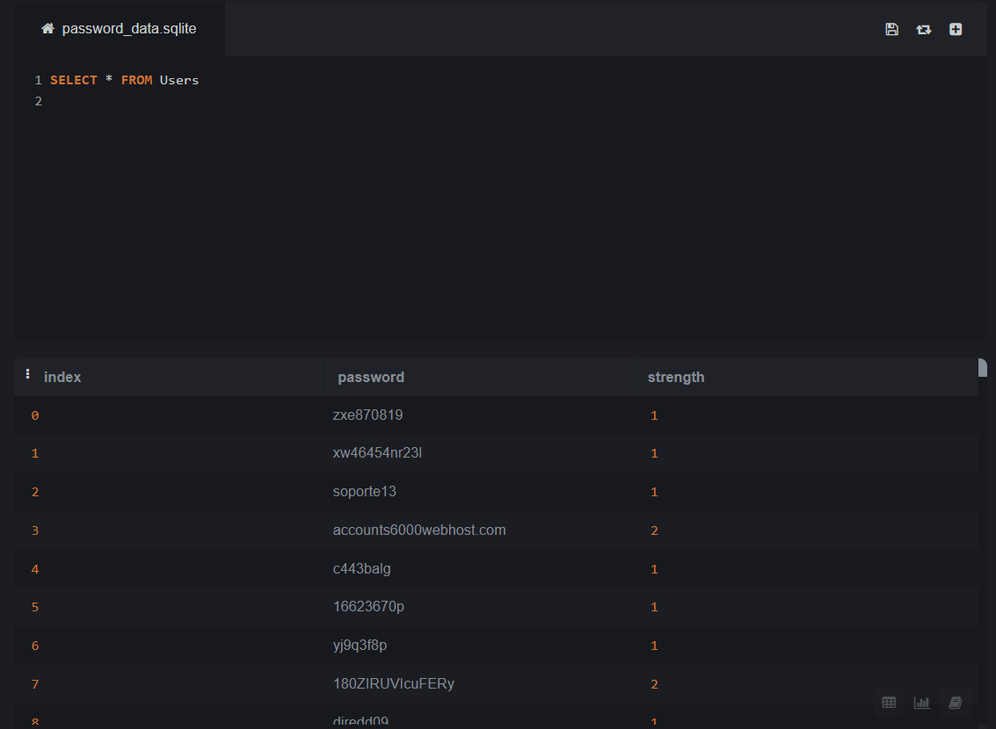
Dataset

Slide 8
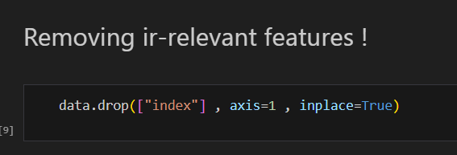
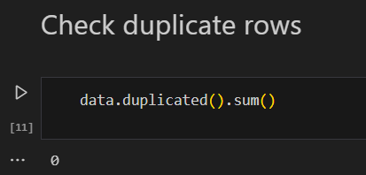
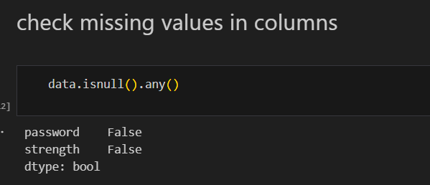
Data Cleaning
The data was cleaned using various methods

Slide 9
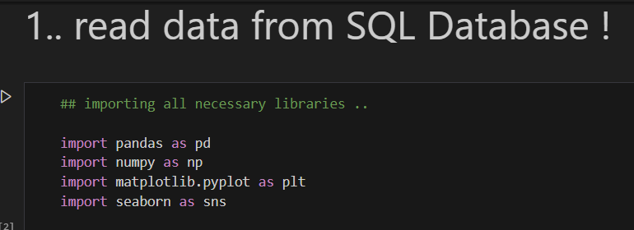
Database Connectivity & Libraries
We used the stored password from database and performed the analysis accordingly.
Library are used as follows :-

Slide 10
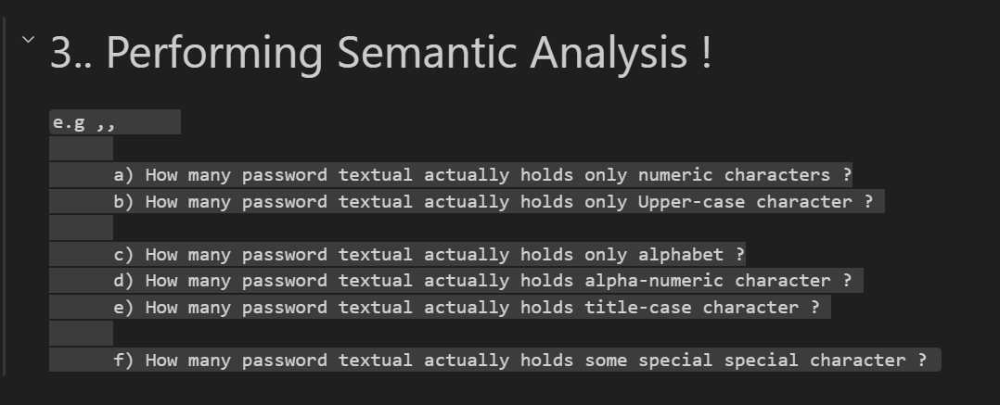
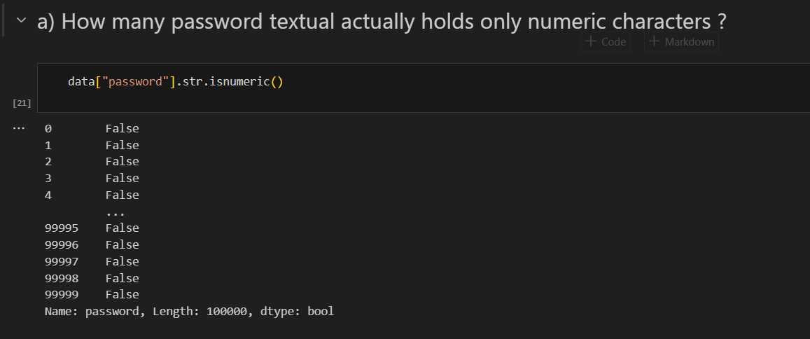
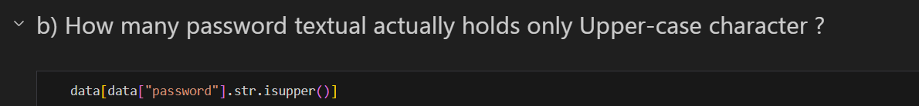
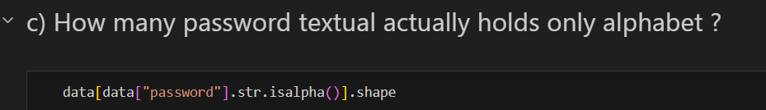
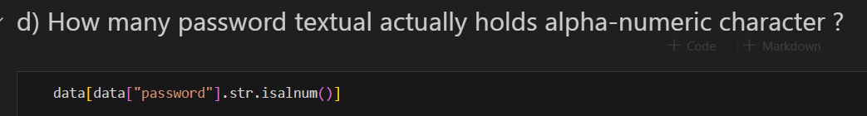
The Semantic Analysis

Slide 11
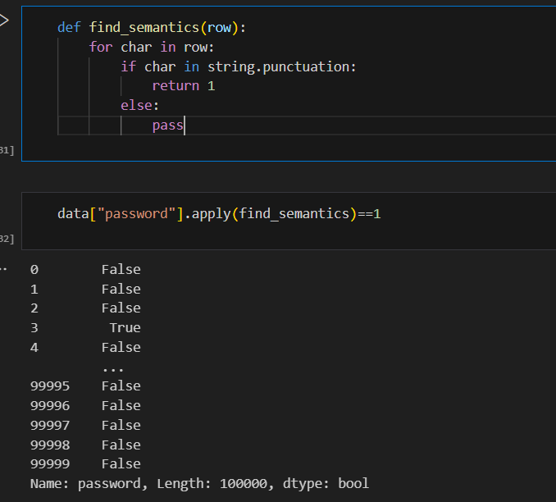
Special Characters
We have defined a function to find the semantic value with the if/else condition
What are special characters:
Answer: '!"#$%&\'()*+,-./:;<=>?@[\\]^_`{|}~'

Slide 12
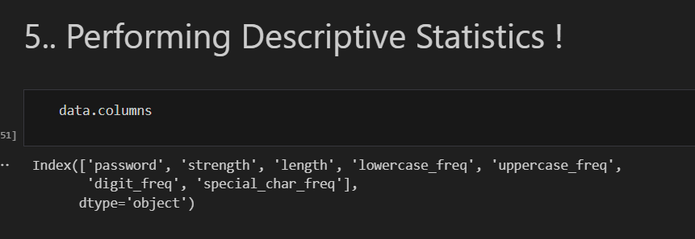
Applying Feature Engineering
So I have performed Descriptive Statistics and created new values
We have password strength to check what features password depends on:-
It depends on 5 factors :
Length of password
Frequency of Lowercase Characters
Frequency of Uppercase Characters
Frequency of Numeric Characters
Frequency of Special Characters

Slide 13
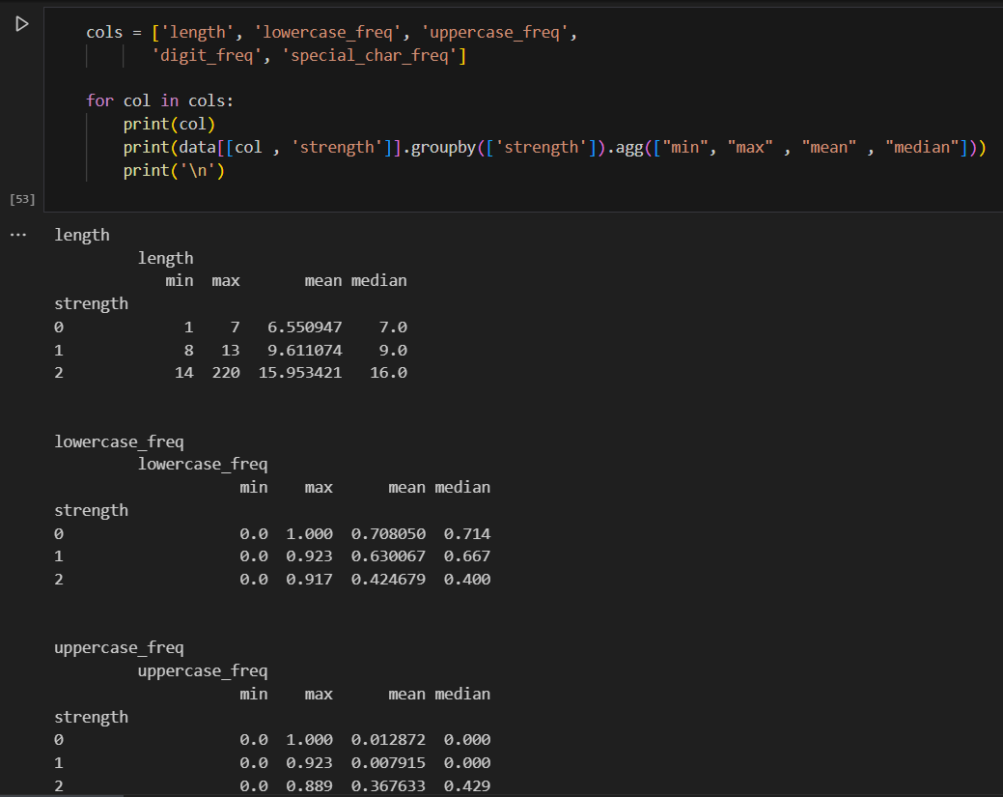
Higher the length, Higher the strength
->> In case on alphabet frequency higher is not better.
Probably because it'll not be a strong password if max portion is occupied by just alphabets..
Password has more strength if the char types are spread in decent proportions.

Slide 14
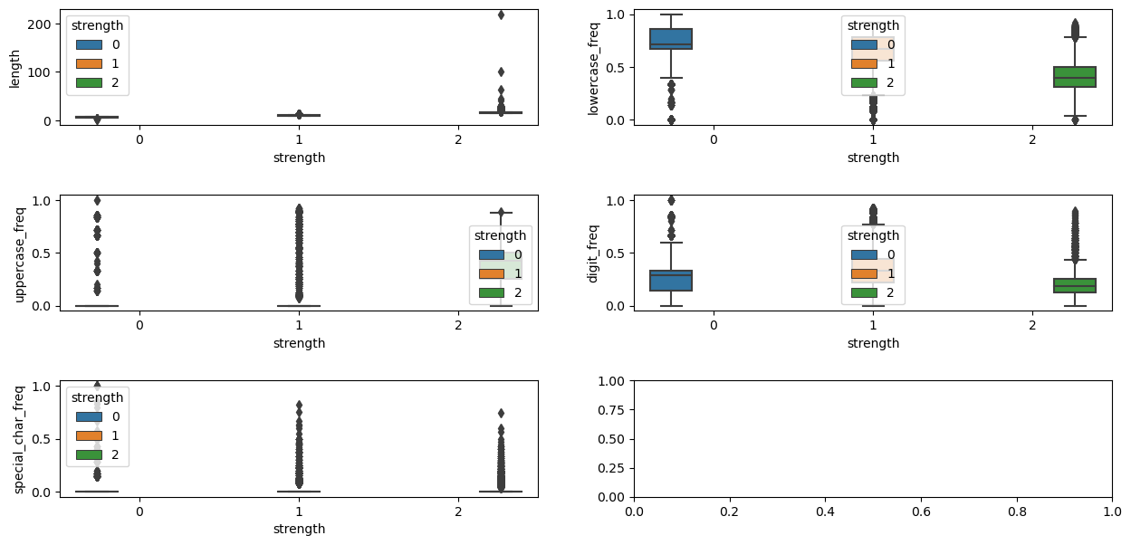
Using Boxplot from Seaborn package for Data Visualization

Slide 15
Insights
Regarding the insights we can say that:-
->> Higher Lowercase frequency is seen in low strength passwords.
For higher strength passwords , Lowercase frequency can be high too but that is probably effect of length.
->> In digit_freq there is a split of majority poplutation of strength 1 and 2 but for 0 and 1 strength , there is overlap so no too much to say there.
But we can say a nicely propotioned password is good..
->> In upper_freq , there is a trend but not as strong as length or lower_freq..
->> Similar but stronger same trend as above in special_freq.
->> Higher strength passwords have more type breaks.

Slide 16
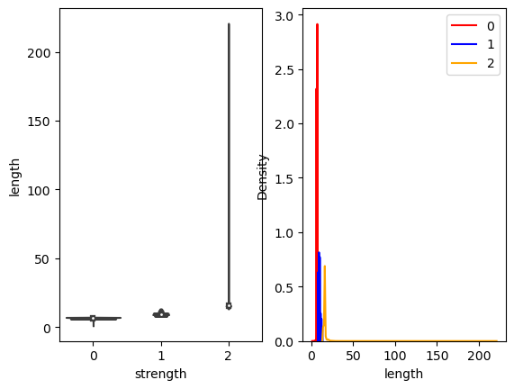
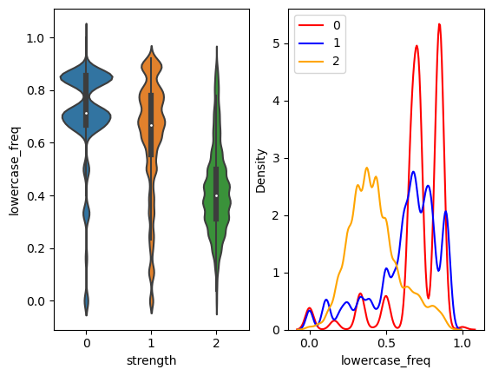
Build an Univariate Analysis
Using the color-labeled marker, We create a Violinplot & Distribution plot for the strength of the password of each column.
when class is 2 , we have higher value of 'length' than class 1 & class 0

Slide 17
When class is 2 , we have less value of 'lower_freq' than class 1 & class 0
It means 'lower_freq' is a interesting feature upto some extent as have some overlapping region
Similarly from violinplot ,we will say on account of such overlapping.
When class is 2 we have less value of 'lower_freq' than class 1 & class 0
This feature 'lower_freq' is a interesting feature upto some extent in determining the strength

Slide 18
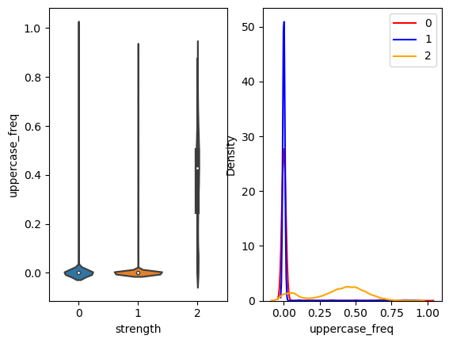
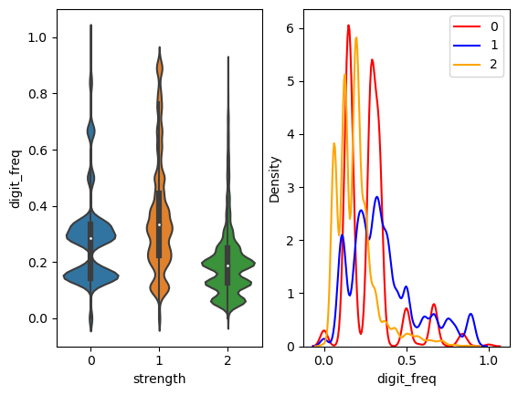
Build an Univariate Analysis
Using the color-labeled marker, We create a Violinplot & Distribution plot for the strength of the password of each column.
UPPERCASE_FREQ DIGIT_FREQ

Slide 19
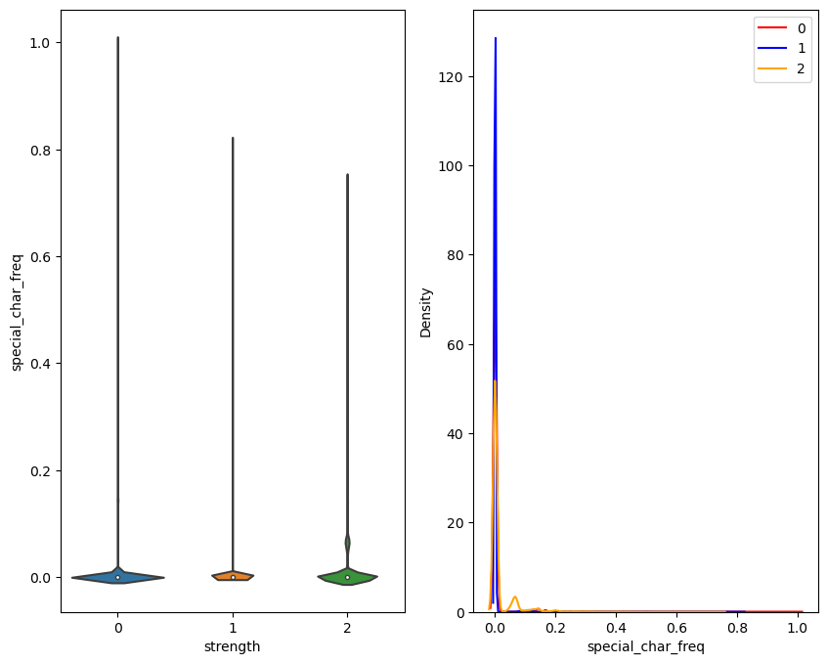
Build an Univariate Analysis
SPECIAL CHARACTER FREQUENCY

Slide 20
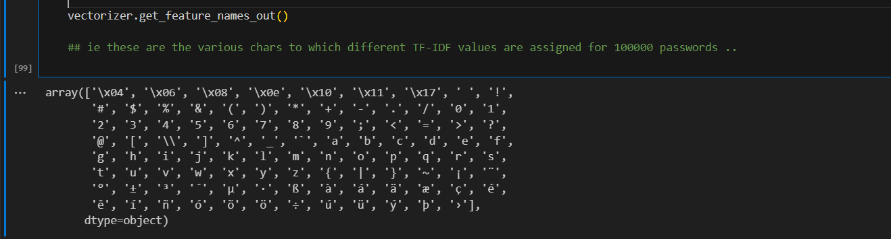
TF & IDF – TERM FREQUENCY & INVERSE DOCUMENT FREQUENCY
TF X IDF = VECTOR Representation which will be passed in Machine Learning Algorithm
Convert the password text to Vector by importing Tfidvectorizer

Slide 21
Applying Machine Learning Algorithm
Logistics Regression
Continuous in nature (to predict the password strength)
Classification
To Classify the password as 0,1,2 – Poor, Average or Strong
Clustering
Creating a Cluster of Pupil which has same property

Slide 22
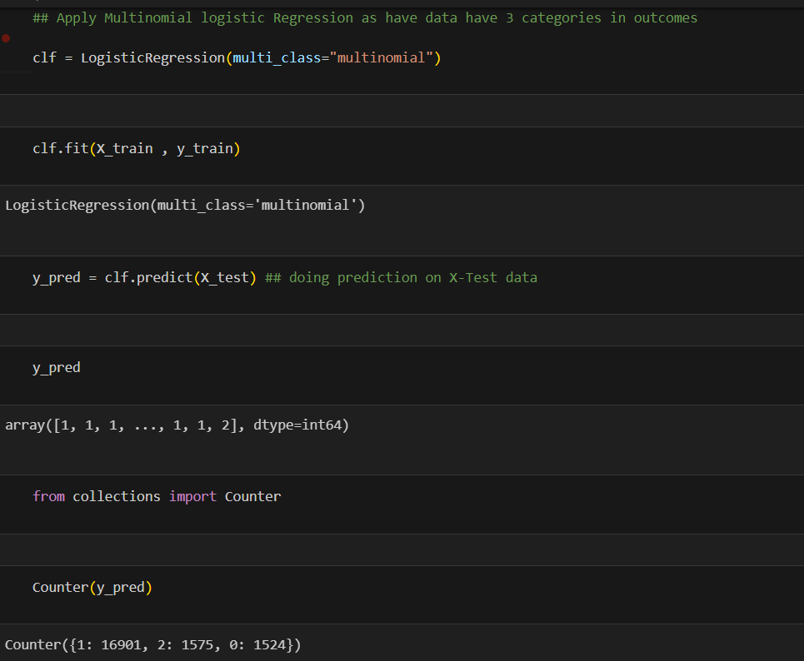
Training the Machine
First, We are training the machine to learn our data and after we will be testing the Machine in our next slide

Slide 23
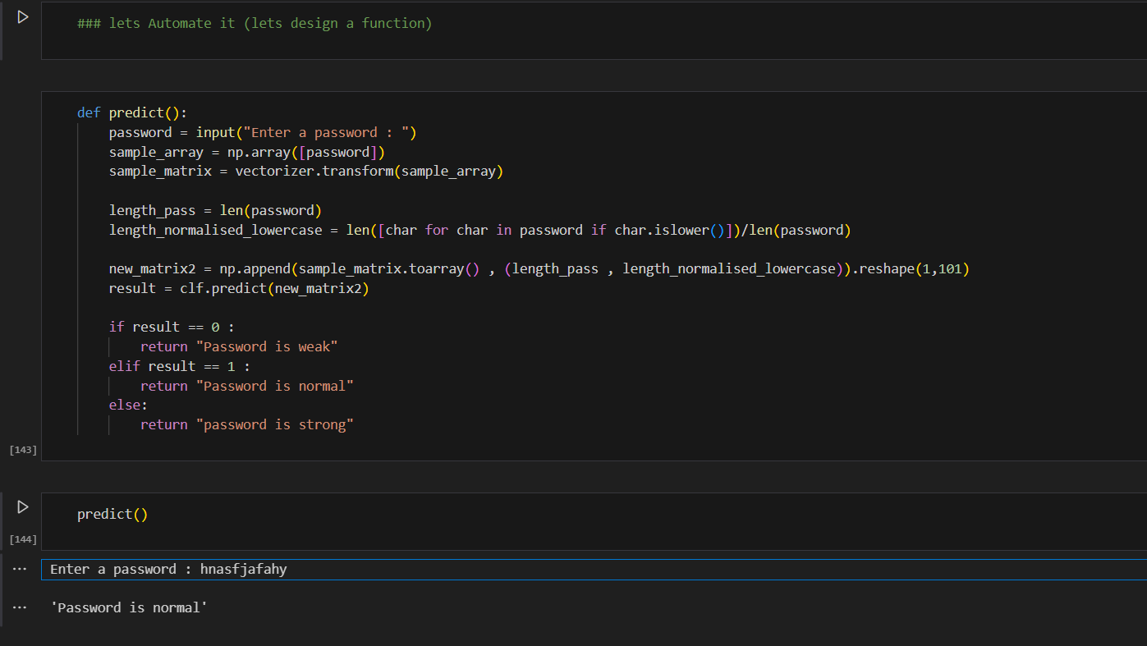
Doing Prediction on Sample data (User entered)
Password = “%@123abcd”
In Vectorizer, Simply call a transform function and mention the array

Slide 24
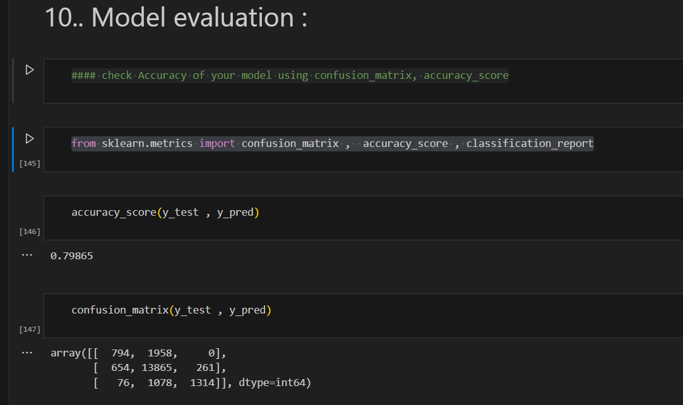
Model Evaluation
Check Accuracy of your model using confusion_matrix, accuracy_score
from sklearn.metrics import confusion_matrix , accuracy_score , classification_report
Our Accuracy is slightly closer to 80%

Slide 25


